Slide 1
Social Meadia Website
Task- 1

Slide 2

 | Social Meadia Website
CB2_2
LMS Username |  | Name | Batch
au612820104026 |  | Santhosh M | CB2_2
au612820104004 |  | Anbu S | CB2_2
au612820104015 |  | Parthibaraj A | CB2_2
au612820104032 |  | Srikanth D | CB2_2

Slide 3

Task - 1
Creation of SRS & Github
Create SRS : “Your Project”
Creation & Set-up of Github account
Creation & Hands-on to various commands of Git Bash
Evaluation Metric:
100% Completion of the above tasks
Learning Outcome
Get to know about different lifecycle models.
Understanding importance and how to create an SRS
Knowing various commands of Github
Understanding agile and scrum management techniques for efficient product development

Slide 4
Introduction
Social media refers to online platforms and websites that enable people to interact,
share content, and communicate with each other in virtual communities. These platforms allow users to create and share content in various formats, including text, images, videos, and more. Social media has become an integral part of modern communication, allowing individuals, businesses, and organizations to connect, engage, and build communities worldwide.

Slide 5
Project Overview
Project Objective:
Clearly state the primary objective of your project. What do you intend to achieve by the end of the project? For example, it could be to increase brand awareness, analyze social media engagement, or develop a social media marketing strategy.
Project Scope:
Define the boundaries of your project. What social media platforms will you
focus on? Which specific areas of social media will you explore? Is it a research
project, a marketing campaign, or something else?

Slide 6
Project Phases
Planning
Design
Development
Testing
Launch
Maintenance and Updates

Slide 7
Requirement
Software Configuration:
Operating System: Windows NT, windows 98, Windows XP
Language: Java Runtime Environment, Net beans 7.0.1 (front end)
Database: MS SQL Server (back end)

Slide 8
Hardware Configuration:
Processor: Pentium(R)Dual-core CPU
Hard Disk: 40GB
RAM: 256 MB
Content Delivery Network (CDN): CDN to deliver static
Web Hosting Server: AWS, Azure, Google Cloud

Slide 9
Proposed System
User sign-up process with verification mechanisms (email, phone, etc.).
Secure authentication protocols for user logins.
Ability for users to create and manage their profiles.
Profile customization options, including profile pictures, bios, etc.

Slide 10
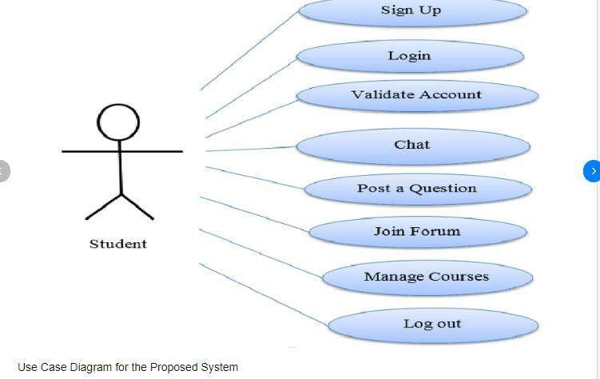
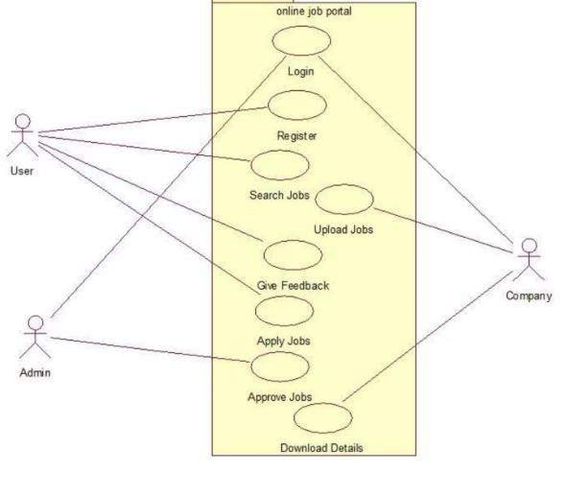
Use case Diagram

Slide 11
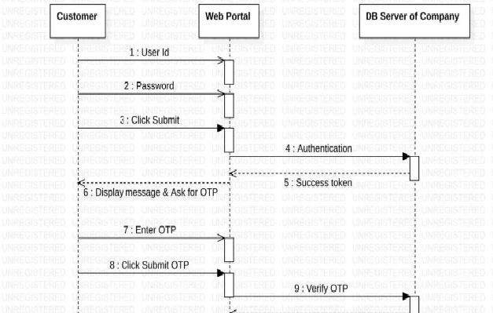
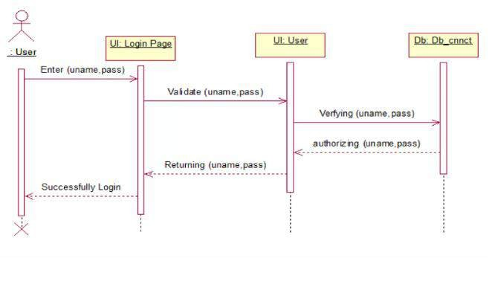
Sequence Diagram
User login

Slide 12


Assessment Parameter
Gather requirements for the
project
add Readme.md file with
description of the project
Prepare database design
schemas
Check-List
Commit all changes with "first commit"
Get your initial project
Structure ready
create a repository on github related to project
Initiate a git repository
Push your changes to github

Slide 13


Submission Github
https://github.com/santhoshjava2002 https://github.com/anbu57 https://github.com/dsrikanth979 https://github.com/Parthibaraj524

Slide 14


